Slide 1
Azure Infrastructure as Code Bootcamp
Session 1 of 6: Infrastructure as Code
Session materials repository: timw.info/inebootcamp

Slide 2




Tim Warner
timothywarner316@gmail.com
@TechTrainerTim
timw.info/linkedin

Slide 3
Bootcamp Overview
Session 1: Infrastructure as Code
Session 2: Azure Compute Services
Session 3: Azure Network Services
Session 4: Azure High Availability & Fault Tolerance
Session 5: Azure Storage Services
Session 6: Identity and Access Management

Slide 4
Session 1 Agenda
Foundational principles
Git version control
Microsoft Azure infrastructure as code
Deploy infrastructure with CI/CD pipelines

Slide 5
Course Materials
timw.info/inebootcamp

Slide 6
Foundational Principles

Slide 7
Why IaC?

Slide 8
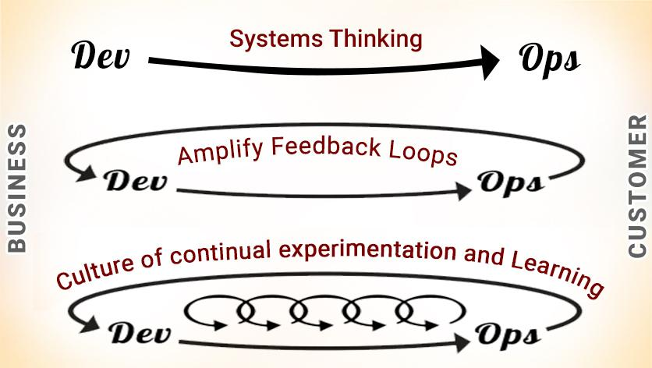
DevOps

Slide 9




DevOps Reading List

Slide 10
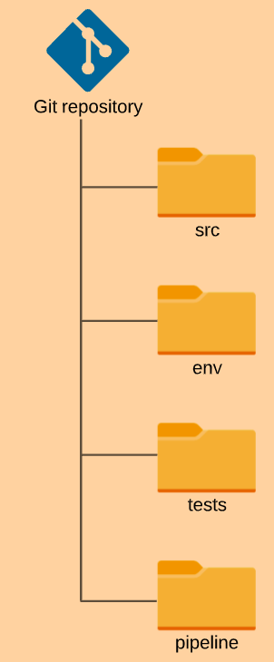
GitOps

Slide 11
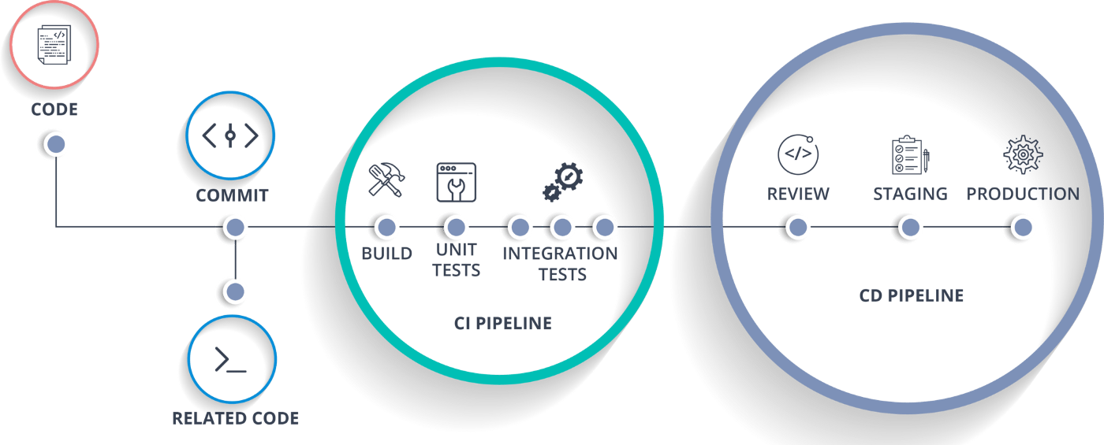
CI/CD

Slide 12
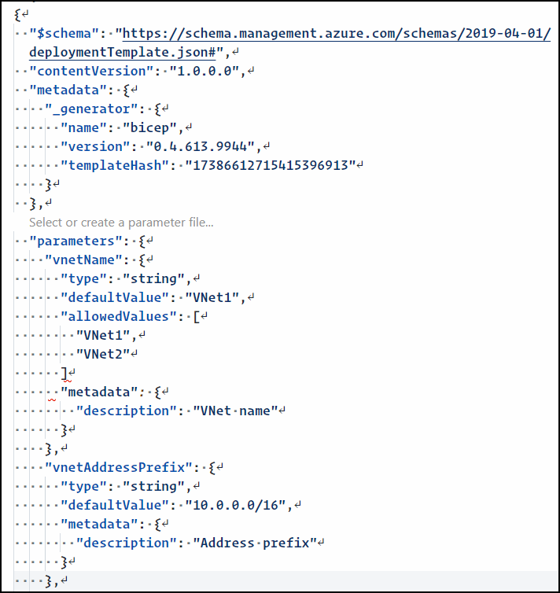
JavaScript Object Notation (JSON)

Slide 13
Git Source Code Control

Slide 14
Git

Slide 15
GitHub

Slide 16
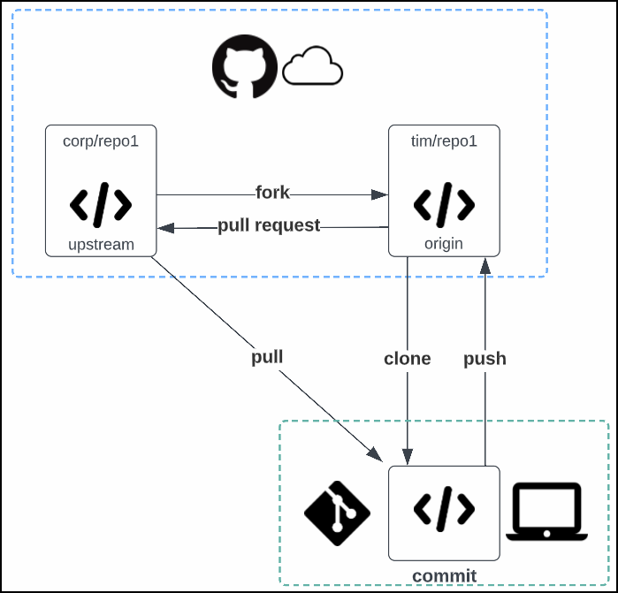
Git/GitHub Flow

Slide 17
Demo 1 of 3: Git and GitHub

Slide 18
Microsoft Azure Infrastructure as Code

Slide 19
ARM JSON Deployment Templates

Slide 20
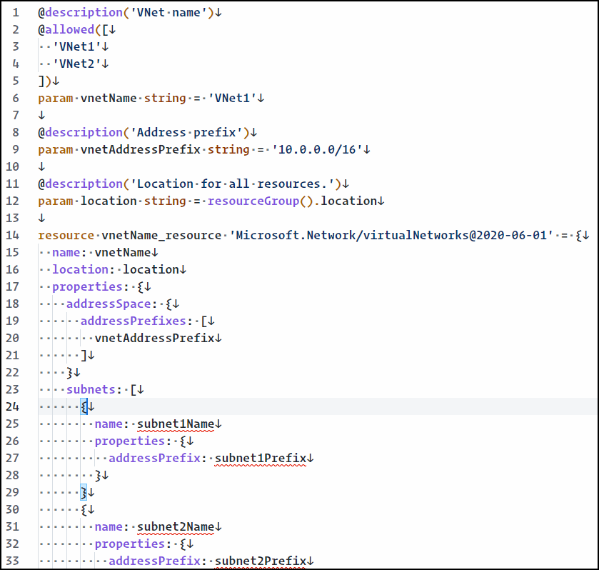
Azure Bicep

Slide 21
Demo 2 of 3: ARM Templates with a Side of Bicep

Slide 22
Deploy Infrastructure with CI/CD Pipelines

Slide 23
Title

Slide 24
Demo 3 of 3: ARM Templates in Azure DevOps Pipelines

Slide 25
Azure DevOps

